Slide 1
Iowa Assessments –
Red Oak Results
January 2013

Slide 2
This is all students not just full academic year – which is used by the Department of education

Slide 3
Data for the previous graph
(apples to oranges)
 | Reading |  | Math |  | Science
Grade | 2011-12 | 2012-13 | 2011-12 | 2012-13 | 2011-12 | 2012-13
2 | 72% | 85% | 60% | 79% | 58% | 67%
3 | 70% | 70% | 70% | 78% | 84% | 89%
4 | 70% | 73% | 70% | 87% | 79% | 78%
5 | 61% | 71% | 76% | 81% | 73% | 81%
6 | 44% | 46% | 66% | 62% | 66% | 65%
7 | 51% | 56% | 67% | 72% | 67% | 79%
8 | 64% | 56% | 68% | 69% | 73% | 78%
9 | 88% | 80% | 80% | 74% | 91% | 79%
10 | 87% | 87% | 82% | 83% | 88% | 89%
11 | 87% | 86% | 80% | 81% | 87% | 87%

Slide 4
A closer look at reading (Apples to apples)

Slide 5
A closer look at math (apples to apples)

Slide 6
A closer look at science (apples to apples)

Slide 7
Data for the previous graphs
 | Reading |  | Math |  | Science
Grade | 2011-12 | 2012-13 | 2011-12 | 2012-13 | 2011-12 | 2012-13
2 |  | 85% |  | 79% |  | 67%
3 | 72% | 70% | 60% | 78% | 58% | 89%
4 | 70% | 73% | 70% | 87% | 84% | 78%
5 | 70% | 71% | 70% | 81% | 79% | 81%
6 | 61% | 46% | 76% | 62% | 73% | 65%
7 | 44% | 56% | 66% | 72% | 66% | 79%
8 | 51% | 56% | 67% | 69% | 67% | 78%
9 | 64% | 80% | 68% | 74% | 73% | 79%
10 | 88% | 87% | 80% | 83% | 91% | 89%
11 | 87% | 86% | 82% | 81% | 88% | 87%

Slide 8
Targets
By 2014, all grade levels 100% proficient – if nothing changes at the State Level – no waiver for NCLB
This does not show growth – we have made some great gains.

Slide 9
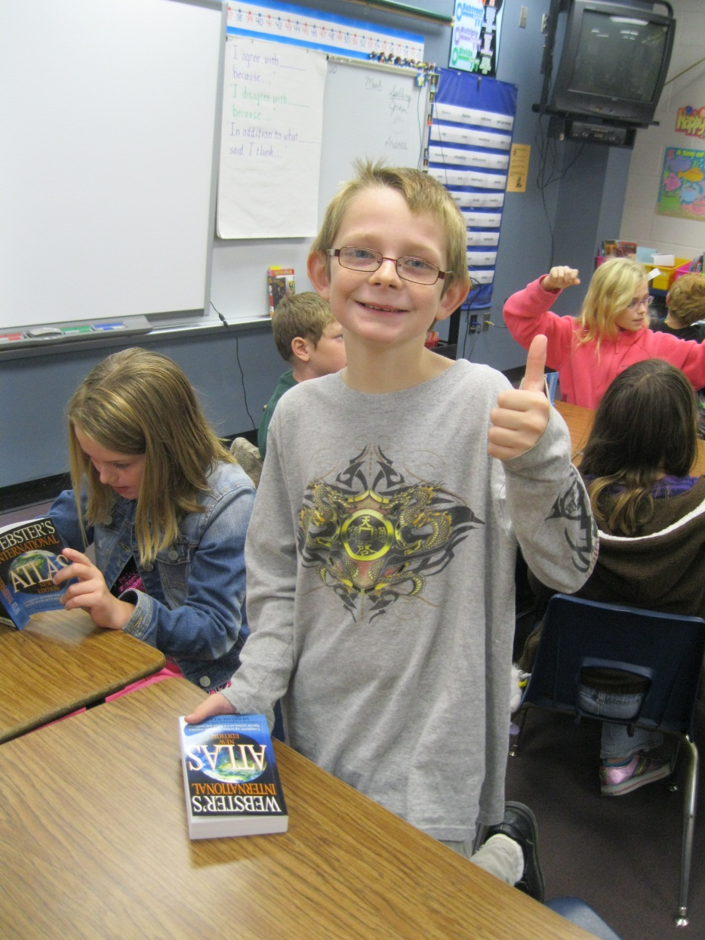
Questions?

