Slide 1

Red Oak Community School District
School Improvement Advisory Committee

Slide 2

Observations and Questions
Feedback from February Meeting

Slide 3

What did we learn?
We were concerned about the results of the student voice grade results. Ex: When students don’t have “heroes” or feel they may fail, they won’t score well on tests.
The growth of each student – proficiency vs. growth
Achievement of students through scores compared to the state. The numbers were helpful.
Need to come up with ideas to improve student to student respect.
School environment:
  Work hard at that
  Sharing the results
  Kids need to be happier and comfortable at the school.

Slide 4
What do we still want to know?
Alternative school – how many students does this take in? Is their degree the same as a regular diploma? Would like more knowledge about this.
  About 20 students each year for the last 2 years
  This year there are 10 full-time students and about 25 credit recovery students
Notes:
The number of students varies each year. Last 2 years the program has served about 20 students each year. This year, there are 10 students full-time and also about 25 students in credit recovery.
Students earn the same diploma as students in regular high school classes.
Mr. Eubank talks with staff to determine what content needs to be covered with students. He has purchased materials to fit the environment and has access to the program Odysseyware. This can be used at school or in homebound situations. Mr. Eubank is able to customize the classes to be able to use the full class or only what the student needs to recover the class.

Slide 5
What do we still want to know?
College and Career Readiness – What are the standards used to measure this? For the School Report Card:
  Cut scores of 22 on Reading and 22 on Math on the ACT represent college readiness.
Notes:
A study conducted by Iowa Testing Programs translated the Iowa Assessments scores to the college readiness scores on the ACT.
A benchmark aligned to the ACT is set for students at each grade level.
Individual growth goals are created for each student based on their prior year National Standard Score and the amount of growth needed to score 306, which is considered “college and career ready,” by grade 12.
They literally subtract a student’s score from 306 and then divide that by the number of years left to 12th grade. Ie: An 8th grade student standard score of 235 would mean that the student is not college and career ready. The student needs to grow 17.75 points each year to be college and career ready by grade 12.
School Report Card Technical Guide: https://reports.educateiowa.gov/schoolreportcard//content/2017TechnicalGuideIowaReportCardv3.pdf
For students already above the CCR goal, “the trajectory and growth target will be the annual expected growth in the 35-65 percentile range.”
“The individual CCR goal will always be equal to or greater than the expected growth goal at the 50th percentile for the student’s current grade.”

Slide 6
What do we still want to know?
How does Red Oak Schools rate on a nationwide basis?
2017 | Red Oak | Iowa | U.S.
English | 20.5 | 21.2 | 20.3
Math | 19.2 | 21.3 | 20.7
Reading | 21.7 | 22.6 | 21.4
Science | 21.2 | 22.1 | 21
Composite | 20.7 | 21.9 | 21
2018 | Red Oak | Iowa | U.S.
English | 19.1 | 21 | 20.2
Math | 19.7 | 21.2 | 20.5
Reading | 21.7 | 22.5 | 21.3
Science | 20.3 | 22 | 20.7
Composite | 20.6 | 21.8 | 20.8
Notes:
http://www.act.org/content/dam/act/unsecured/documents/cccr2018/Iowa-CCCR-2018.pdf
These are ACT scores for our students compared to Iowa and the nation.
There isn’t a good comparison, nationally, on Iowa Assessments. Our students get a national standard score and percentile rank, but it’s compared to a 2011 norming group. Not everyone takes the assessment and the norms are old. For this reason, I didn’t attempt to compare us nationally on Iowa Assessments.

Slide 7
What do we still want to know?
Does changing teachers affect scores and discipline comparing elementary and secondary? Secondary has low scores and discipline.
Notes:
If class is disrupted, student learning is obviously disrupted for the student causing the disruption as well as for others.
Classroom management in general has an impact on learning.
Research from Visible Learning (John Hattie) shows an effect size of .52. An effect size of .4 is equivalent to 1 year of growth. Based on Hattie’s research, which is a synthesis (combination) of over 800 other meta-analyses, when considering influences on student achievement, this is actually ranked 42nd. To put this in perspective, teacher-student relationships have an effect size of .72 and rank 11th.
Meta-analysis is the statistical procedure for combining data from multiple studies. When the treatment effect (or effect size) is consistent from one study to the next, meta-analysis can be used to identify this common effect.

Slide 8
What do we still want to know?
Is there a way to get the kids more involved in seeing the data?
  Tiger Link Crew
  Mrs. Erickson & Mrs. Vannausdle – with staff support
Notes:
This is in the works. A committee met on Monday to discuss survey results and determine next steps.
A student group, Tiger Link Crew, will be involved with looking at the data and determining next steps as well as implementing those. Mrs. Erickson and Mrs. Vannausdle will be working on this with the support of other staff. Right now, the focus will be on creating a plan for next year and implementing it from the very beginning of the school year.

Slide 9
What do we still want to know?
Is there a way for more kids to have activities during the day/seminar (intramurals)?
Time | Class
8:25 - 9:45 | Block 1 & 2
9:51 - 11:11 | Block 3 & 4
11:15 - 1:07 | Block 5 & 6 / Lunch (80 instructional + 25 lunch + 6 passing)
1:11 - 2:31 | Block 7 & 8
2:35 - 3:30 | Flex & seminar Block
Notes:
The secondary schedule was approved by the board last in February. It includes a flex/seminar time at the end of the day. This time is intended to be used for intervention as well as activities. Several groups will be using this time: FFA, Minnisingers, Band, athletic meetings &/or games, Student Council, BPA, etc.

Slide 10
What do we still want to know?
Is there a way to find out what students think teachers do well to build relationships?
  https://docs.google.com/forms/d/1_m-HcY9QDySP71NwXqbOOgXqj_6pKQlINd77tpEJhJw/edit
Notes:
Secondary staff were given a survey to administer to their classes at the end of 3rd quarter and quarterly thereafter. The survey was developed by Mrs. Erickson and other high school staff and then extended to the middle school staff last week. They had PD yesterday on how to administer the survey and use the results.
The 16 question survey, which teachers cannot change, but can add to, is broken into 5 categories:
Student/Teacher Relationship
Rigorous Expectations
Student Engagement
Pedagogical Effectiveness
Classroom Climate

Slide 11
What do we still want to know?
ACT - more information
> 75% think college
Few are taking it (< 25%)
How many times do they take it?
  As often as they wish
Since when?
  Specific requirements for students age 13 or younger, but students can begin taking it in middle school
Cost?
  $50.50 for the standard ACT
  Adding the writing portion costs $67
Information for parents?
  District website under HS Guidance
  Flyers with test dates, cost, registration, and general info as well as practice ACT tests on the main table during both sessions of P/T Conferences where parents pick up student grades
  Registration deadline and ACT test date in announcements at least 3 weeks prior to the deadline
  Counselor met with all juniors this spring and told all juniors planning to attend 4-year colleges that they need to take it this spring, summer, or fall.
  Juniors planning to attend 2-year colleges or trade schools were told they don’t have to take it to be accepted to those schools.
Notes:
Information about the ACT is on the school website on the HS guidance page. I had ACT flyers with test dates, cost, registration information, etc. on it and practice ACT tests on the main table during both sessions of parent-teacher conferences where parents picked up their students' grades. I have also put the registration deadline and ACT test date in the announcements at least three weeks prior to the deadline.
I have met with all juniors this spring and discussed whether or not they should take the ACT. I have told all juniors planning to attend 4-year colleges that they need to take it this spring, summer, or fall. I have told juniors planning to attend 2-year colleges or trade school that they do not have to take it to be accepted to those schools. I have discussed what the test is and handed all juniors a flyer if they are curious or wanting to take it. Right now I have 34 of 55 juniors planning to take it sometime this year. I have 6 of 55 that aren't sure and 15 of 55 that are not planning on taking it. I still need to meet with 16 juniors.
Students can take the ACT as many times as they want to. They can take it any time in high school. Some may choose to take it in 7th or 8th grade as well and that is allowed. Right now the standard ACT test which includes Reading, Math, English, and Science tests costs $50.50. The ACT test which includes Reading, Math, English, Science, and a Writing portion costs $67. If a student receives free or reduced lunch, they may request an ACT fee waiver and those are available in my office.

Slide 12
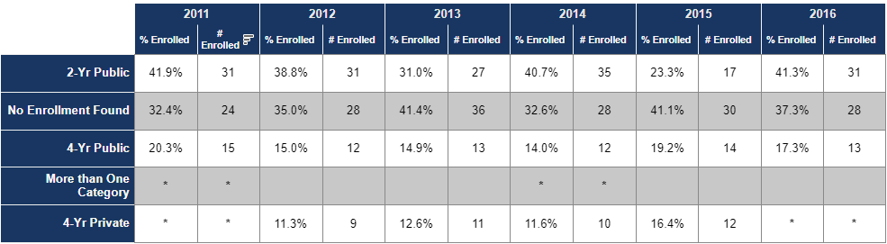
Additional Information
Enrollment in Iowa community colleges and Universities
Notes:
For the Performance Profile, College and Career Readiness will be measured differently. ESSA Plan is calling is PSRI (Postsecondary Readiness Indicator) No score was reported on this year’s profile as they have still been developing the indicators. Proposed indicators are:
Concurrent Enrollment
Post-Secondary Enrollment within 1 year after graduation
Post-Secondary Remediation in mathematics and reading
Successful completion of 15 credits or receipt of an award within the first year of enrollment
This may changed based on the feedback from the stakeholders. This school year, the Department of Ed is developing and piloting an “optimal PSRI” and it will be calculated and added to the performance profile next year.
Our most recent data according to Iowa’s Postsecondary Readiness Report last updated in December is presented here.
The average enrollment from 2014-2016 (within 1 year of graduation) is 63.2%. On average, 12.3% of those who were enrolled took at least 1 remedial English or math course within the 1st year.
https://reports.educateiowa.gov/postsecondaryreadiness

Slide 13
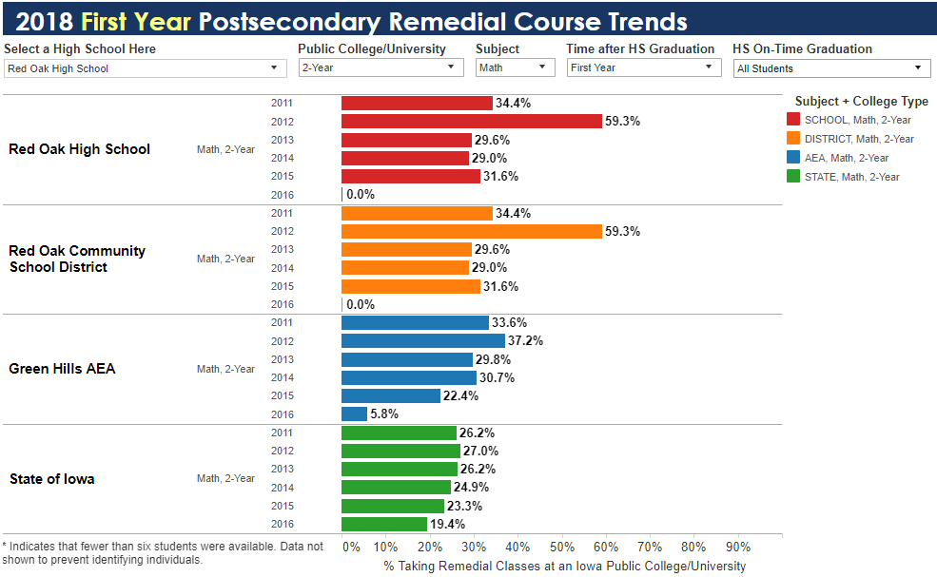
Additional Information
Notes:
Students enrolled in Iowa’s community colleges who took remedial courses in math since 2011.
https://reports.educateiowa.gov/PostSecondaryReadiness/home/remedialCourseTrends

Slide 14
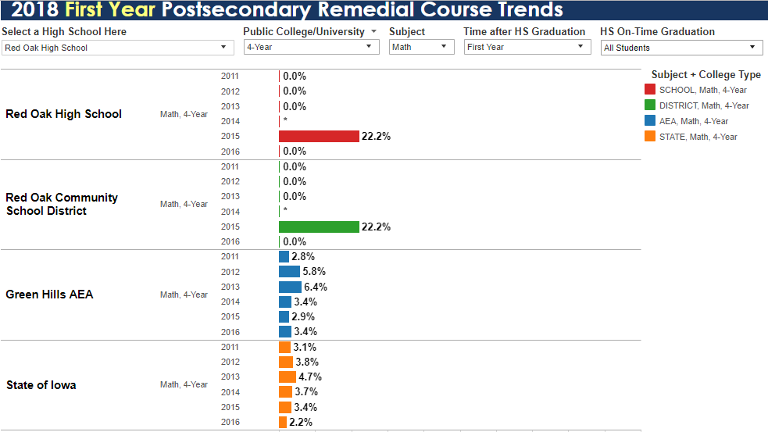
Additional Information
Notes:
0% of our students took remedial courses at Iowa’s 3 universities in all years excluding 2014 when there were fewer than 6 students enrolled and 2015 when 22% of the our students enrolled took a remedial math course.
https://reports.educateiowa.gov/PostSecondaryReadiness/home/remedialCourseTrends

Slide 15
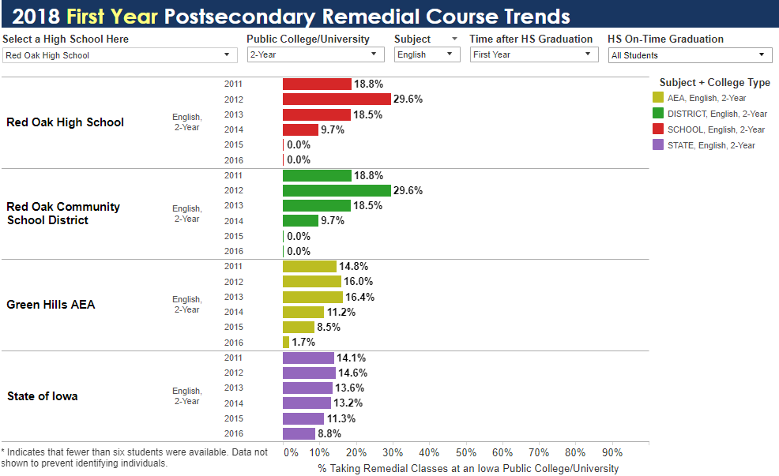
Additional Information
Notes:
Students enrolled in Iowa’s community colleges who took remedial courses in reading since 2011. When looking at Iowa’s 3 universities, no students took remedial courses excluding year 2014 when data was not collected due to having fewer than 6 students. The AEA and state data was 0% or less than 1% for all years, so I didn’t copy that data.
https://reports.educateiowa.gov/PostSecondaryReadiness/home/remedialCourseTrends

Slide 16
What do we still want to know?
Can we get new data when the new school report card comes out in March?
  Still not out, but yes!

